Slide 1
Persistence of Low Pay Employment
Gail Pacheco, Alexander Plum
PLEASE DO NOT CITE WITHOUT AUTHORS’ PERMISSION – THESE ARE PRELIMINARY FINDINGS

Slide 2
SNZ Disclaimer
Access to the data used in this study was provided by Statistics New Zealand under conditions designed to give effect to the security and confidentiality provisions of the Statistics Act 1975.
The results presented in this study are the work of the authors, not of Statistics NZ.

Slide 3
Motivation
Background:
Intensive discussion on inequality (e.g. OECD 2015, IMF 2017)
Numerous studies on the effect of low pay employment on labour market prospects:
stepping-stone towards higher-paid jobs (e.g. Uhlendorff 2006)
no-pay – low-pay cycle (e.g. Stewart 2007)
Studies provide evidence for state dependence in low pay:
P$\left({{\text{Low} \text{pay}}_{t}\text{|}\text{Low} \text{pay}}_{t−1}\right)≥P\left({\text{Low} \text{pay}}_{t}|{\text{Higher} \text{pay}}_{t−1}\right)$

Slide 4
Motivation
Aim of this study:
Discussing the prevailing identification strategy which is based on annual labour market information
Comparing the results with a model that uses a large administrative dataset with monthly earning information and accounts for the intensity of the low pay attachment
Please note that results are preliminary

Slide 5
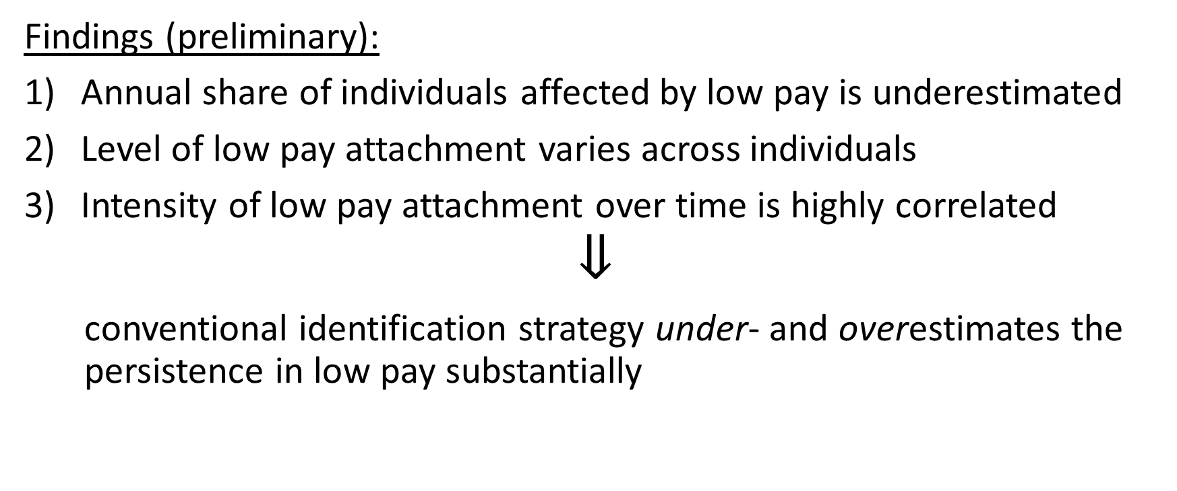
Motivation
Findings (preliminary):
Annual share of individuals affected by low pay is underestimated
Level of low pay attachment varies across individuals
Intensity of low pay attachment over time is highly correlated
$$⇓$$
conventional identification strategy under- and overestimates the persistence in low pay substantially

Slide 6
Literature Review
United Kingdom (BHPS, Understanding Society):
Stewart & Swaffield (1999): ‘considerable persistence in low pay’ [p. 40]
Cai et al. (2017): ‘those employees who are on low pay are more likely to be found on low pay in the future, compared with those who are (…) unemployed or on higher pay’ [p. 27]
Italy (Survey on Households Income and Wealth):
Cappellari (2007): ‘considerable state dependence: the experience of low pay raises the probability of subsequent low pay episodes’ [p. 465].
Germany (GSOEP):
Uhlendorff (2006): ‘strong true state dependence in low pay’ [p. 18]
Europe (ECHP):
Clark & Kanellopoulos (2013): ‘positive, statistically significant state dependence in every single country’ [p. 122]
Australia (HILDA):
Fok et al (2015): ‘Consistent with the previous literature, the results clearly indicate that there is state dependence in (…) low-paid employment’ [p. 885]

Slide 7
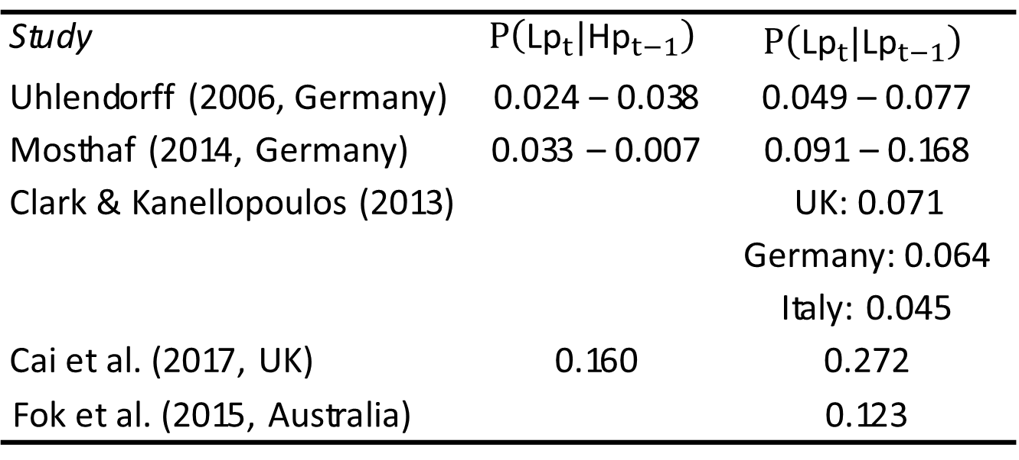
Literature Review
Table 1: Low pay persistence of related studies
Study | $$P\left({\text{Lp}}_{t}|{\text{Hp}}_{t−1}\right)$$ | $$P\left({\text{Lp}}_{t}|{\text{Lp}}_{t−1}\right)$$
Uhlendorff (2006, Germany) | 0.024 – 0.038 | 0.049 – 0.077
Mosthaf (2014, Germany) | 0.033 – 0.007 | 0.091 – 0.168
Clark & Kanellopoulos (2013) |  | UK: 0.071 Germany: 0.064 Italy: 0.045
Cai et al. (2017, UK) | 0.160 | 0.272
Fok et al. (2015, Australia) |  | 0.123

Slide 8
Conceptual Framework
2011
2012
year
Interview
Interview
Conventional approach: Identification of low pay employed with respect to the time point of the interview
However: wages not necessarily constant over the year (job changes, promotion)
However: Inland Revenue (IR) provides information of wages and salaries on the monthly level
Possibility to derive level of attachment to the low pay sector

Slide 9
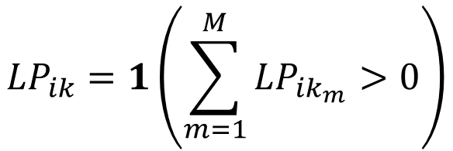
Conceptual Framework
Looking at earning dynamics (e.g. Baker & Solon 2003, Cappellarie & Jenkins 2014):
$$Y_{ik_{m}}=μ_{k}+y_{ik_{m}}$$
With individual $i=1,…,N,$ year $k=1,…,K$ and month $m=1,…,M$
$$y_{ik_{m}}=α_{i}+ν_{ik_{m}}$$
with $α_{i}\sim N(0,σ_{α}^{2})$ and $ν_{ik_{m}}\sim N(0,σ_{ν}^{2})$
$${LP}_{ik_{m}}=1\left(Y_{ik_{m}}≤τ\right)$$
Looking at the annual level
$${LP}_{ik}=1\left(\sum_{m=1}^{M}{{LP}_{ik_{m}}}>0\right)$$

Slide 10
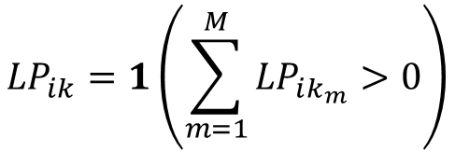
Conceptual Framework
Looking at the annual level:
$${LP}_{ik}=1\left(\sum_{m=1}^{M}{{LP}_{ik_{m}}}>0\right)$$
Share of individuals experiencing low pay employment:
$${LP}_{k}=\frac{\sum_{i=1}^{N}{{LP}_{ik}}}{N×M}≥\frac{{LP}_{ik_{m}}}{N}$$
if $σ_{ν}^{2}>0$
The share of month an individual was low paid employed (low pay attachment):
$${LP}_{ik}^{\text{s}}=\frac{\sum_{m=1}^{M}{{LP}_{ik_{m}}}}{M}≥{LP}_{ik_{m}}$$
if $σ_{ν}^{2}>0$

Slide 11
Conceptual Framework
Correlation of low pay attachment over time:
$$corr\left({LP}_{ik}^{\text{s}},{LP}_{ik+1}^{\text{s}}\right)≥corr\left({LP}_{ik_{m}},{LP}_{i{k+1}_{m}}\right)$$
if $σ_{ν}^{2}>0$
$$Y_{ik_{m}}=μ_{k}+α_{i}+ν_{ik_{m}}$$
$$Y_{ik}={M×μ}_{k}+M×α_{i}+\sum_{m=1}^{M}{ν_{ik_{m}}}$$
$${\overline{Y}}_{ik}=μ_{k}+α_{i}+\frac{\sum_{m=1}^{M}{ν_{ik_{m}}}}{M}$$
$$\overset{→}{M→∞}0$$

Slide 12
Simulation
Design:
5000 individuals, each employed for 12 month
$μ=\log\left(2000\right)$
$σ_{α}=log⁡(2)$
$σ_{v}=\left\{\log\left(1\right),\log\left(1.1\right)…\log\left(2\right)\right\}$
$τ=25th percentile$
100 replications

Slide 13
Simulation

Slide 14
Simulation

Slide 15
Descriptive Statistics
Statistics New Zealand’s Integrated Data Infrastructure (IDI):
IDI links longitudinal microdata about individuals, households etc. from various sources
Backbone is the Central Linking Concordance (CLC) which contains a list of all individuals with some characteristics (e.g. sex, date of birth)
Inland Revenue tax data (IR):
Information on person tax data from Inland Revenue
Data are provided from 1 April 1999 onwards and the geographic coverage refers to all New Zealand
Data are collected and supplied monthly to the IDI
For our analysis we use the gross earnings before tax that come from wages and salaries

Slide 16
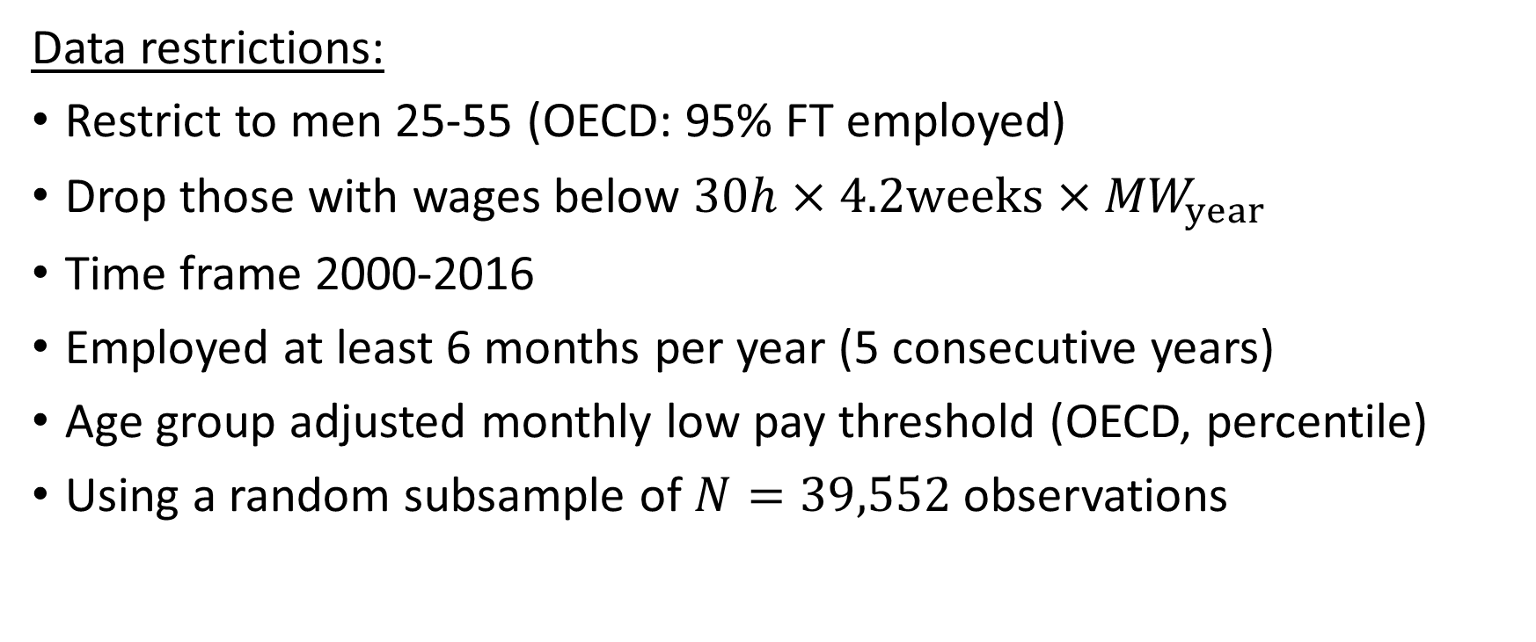
Descriptive Statistics
Data restrictions:
Restrict to men 25-55 (OECD: 95% FT employed)
Drop those with wages below $30h×4.2weeks{×MW}_{year}$
Time frame 2000-2016
Employed at least 6 months per year (5 consecutive years)
Age group adjusted monthly low pay threshold (OECD, percentile)
Using a random subsample of $N=39,552$ observations

Slide 17
Descriptive Statistics
Source: IDI (2018) and own calculations. N= 39,552

Slide 18
Descriptive Statistics
Table 3: Comparing marker
 |  | Group marker_{t}
 |  | No Lp_{t} | Lp <25%_{t} | Lp 25-50%_{t} | Lp >50%_{t}
Annual marker_{t} | No Lp_{t} | 79.22% | 12.89% | 4.79% | 3.11% | 81.82%
 | Lp_{t} | - | 30.94% | 16.06% | 53.00% | 18.18%
 |  | 64.81% | 16.17% | 6.84% | 12.18%
Source: IDI (2018) and own calculations. N= 39,552

Slide 19
Descriptive Statistics
Table 3: Comparing marker
 |  | Group marker_{t}
 |  | No Lp_{t} | Lp <25%_{t} | Lp 25-50%_{t} | Lp >50%_{t}
Annual marker_{t} | No Lp_{t} | 79.22% | 12.89% | 4.79% | 3.11% | 81.82%
 | Lp_{t} | - | 30.94% | 16.06% | 53.00% | 18.18%
 |  | 64.81% | 16.17% | 6.84% | 12.18%
Source: IDI (2018) and own calculations. N= 39,552

Slide 20
Descriptive Statistics
Source: IDI (2018) and own calculations. N= 39,552

Slide 21
Descriptive Statistics
Source: IDI (2018) and own calculations. N= 39,552

Slide 22
Descriptive Statistics
Table 4: Transition matrix
 | No Lp_{t} | Lp <25%_{t} | Lp 25-50%_{t} | Lp >50%_{t}
No Lp_{t-1} | 88.75% | 9.48% | 1.18% | 0.6% | 64.94%
Lp <25%_{t-1} | 43.69% | 39.36% | 12.08% | 4.88% | 16.3%
Lp 25-50%_{t-1} | 13.61% | 31.74% | 31.42% | 23.23% | 6.84%
Lp>50%_{t-1} | 2.69% | 8.4% | 14.03% | 74.88% | 11.92%
 | 66.01% | 15.74% | 6.56% | 11.7%
Source: IDI (2018) and own calculations. N= 39,552

Slide 23
Econometric Model
Basic concept:
First-order Markov process: lagged dependent variable has a genuine effect
Controlling for unobserved heterogeneity (Heckman 1981a) and its correlation with the initial conditions (Heckman 1981b)
Applying a multivariate random effects probit model which was also used in various other low pay studies (Stewart 2007, Buddelmeyer et al. 2010, Knabe & Plum 2013, Clark & Kanellopoulos 2013)

Slide 24
Econometric Model
The following binary outcome variables are defined as:
$y_{it}^{\left(hp\right)}=\left\{\begin{matrix}1 & \text{no} \text{low}\text{−}\text{pay} \text{spells}\text{,} \\ 0 & \text{otherwise}\end{matrix}\right.$
$$y_{it}^{\left(lp 1\right)}=\left\{\begin{matrix}1 & \text{low}\text{−}\text{pay} \text{spells}\text{ < }\text{25} \text{percent}\text{,} \\ 0 & \text{otherwise}\end{matrix}\right.$$
$$y_{it}^{\left(lp 2\right)}=\left\{\begin{matrix}1 & \text{low}\text{−}\text{pay} \text{spells} \text{25 − 50} \text{percent}\text{,} \\ 0 & \text{otherwise}\end{matrix}\right.$$
$$y_{it}^{\left(lp 3\right)}=\left\{\begin{matrix}1 & \text{low}\text{−}\text{pay} \text{spells} \text{> 50 }\text{percent}\text{,} \\ 0 & \text{otherwise}\end{matrix}\right.$$

Slide 25
Econometric Model
The observed binary outcome variables are:
$$y_{it}^{\left(hp\right)}=1\left(γ_{11}y_{it−1}^{\left(lp 1\right)}+γ_{12}y_{it−1}^{\left(lp 2\right)}+γ_{13}y_{it−1}^{\left(lp 3\right)}+x_{1it}^{′}β_{1}+α_{1i}+u_{1it}>0\right)$$
and if $y_{it}^{\left(hp\right)}=0,$
$$y_{it}^{\left(lp 1\right)}=1\left(γ_{21}y_{it−1}^{\left(lp 1\right)}+γ_{22}y_{it−1}^{\left(lp 2\right)}+γ_{23}y_{it−1}^{\left(lp 3\right)}+x_{2it}^{′}β_{2}+α_{2i}+u_{2it}>0\right)$$
and if $y_{it}^{\left(hp\right)}=0$ and $y_{it}^{\left(lp 1\right)}=0$,
$$y_{it}^{\left(lp 2\right)}=1\left(γ_{31}y_{it−1}^{\left(lp 1\right)}+γ_{32}y_{it−1}^{\left(lp 2\right)}+γ_{33}y_{it−1}^{\left(lp 3\right)}+x_{3it}^{′}β_{3}+α_{3i}+u_{3it}>0\right)$$

Slide 26
Econometric Model
To take care of the “initial conditions problem”, we follow the suggestion of Wooldridge (2005) by applying a conditional random-intercept model:
$$α_{ji}=π_{j1}y_{i0}^{\left(lp 1\right)}+γ_{j2}y_{i0}^{\left(lp 2\right)}+γ_{j3}y_{i0}^{\left(lp 3\right)}+{\overline{x}}_{jit}^{′}δ_{j}+κ_{ji}$$
with $j∈\left\{1,2,3\right\},u_{jit}\sim N\left(0,1\right)$, $κ_{ji}\sim N\left(0,σ_{κ_{j}}^{2}\right).$
$$MSL=\prod_{i=1}^{N}{\frac{1}{R}\sum_{r=1}^{R}{\left\{\prod_{t=1}^{T_{i}}{P_{it}\left(κ_{1}^{r},κ_{2}^{r},κ_{3}^{r}\right)}\right\}}}$$
$⇒$ All written in Mata

Slide 27
Results
Table 5: Regression results
 | No Lp_{t} | Lp <25%_{t} | Lp 25-50%_{t}
No Lp_{t-1} | reference category
Lp <25%_{t-1} | -0.656 | -0.473 | 0.143
 | (0.027) | (0.042) | (0.083)
Lp 25-50%_{t-1} | -1.459 | -1.137 | -0.308
 | (0.043) | (0.047) | (0.081)
Lp>50%_{t-1} | -2.367 | -2.098 | -1.240
 | (0.056) | (0.050) | (0.078)
Initial labour market position | ✔ | ✔ | ✔
Exogenous regressors | ✔ | ✔ | ✔
Random effects (uncorrelated) | ✔ | ✔ | ✔
Source: IDI (2018) and own calculations. N= 35,874

Slide 28
Results
Table 6: Predicted probabilities
 | No Lp_{t} | Lp <25%_{t} | Lp 25-50%_{t} | Lp >50%_{t}
No Lp_{t-1} | 0.777 | 0.178 | 0.028 | 0.017
 | (0.134) | (0.097) | (0.023) | (0.017)
Lp <25%_{t-1} | 0.616 | 0.256 | 0.087 | 0.041
 | (0.166) | (0.089) | (0.052) | (0.033)
Lp 25-50%_{t-1} | 0.390 | 0.269 | 0.182 | 0.160
 | (0.156) | (0.046) | (0.061) | (0.077)
Lp>50%_{t-1} | 0.174 | 0.127 | 0.156 | 0.543
 | (0.094) | (0.029) | (0.033) | (0.104)
Source: IDI (2018) and own calculations. N= 35,874

Slide 29
Results
Table 7: Predicted probabilities (annual data)
 | No Lp_{t} | Lp_{t}
No Lp_{t-1} | 0.865 | 0.135
 | (0.079) | (0.079)
Lp_{t-1} | 0.732 | 0.268
 | (0.113) | (0.113)
Source: IDI (2018) and own calculations. N= 35,874

Slide 30
Conclusion
Findings (preliminary):
Annual share of individuals affected by low pay is underestimated
Level of low pay attachment varies across individuals
Intensity of low pay attachment over time is highly correlated
$$⇓$$
conventional identification strategy under- and overestimates the persistence in low pay substantially

Slide 31
Thank you very much for your time
Questions?

